Slide 1



Enabling a More Resilient Future through Data-driven Investments
Climate Action 2016 Forum
Wednesday, May 4, 2016
11:20 AM-12:30 PM

Slide 2
PANELISTS:
Kayed Lakhia, Federal Emergency Management Agency (FEMA)
Michelle Vigen, Department of Environmental Protection Montgomery County Government, Maryland
Frank Donnelly, Corvias Solutions
Ellory Monks, Re:Focus Partners
Mike Dieterich, Renew and Sustain Consulting

Slide 3
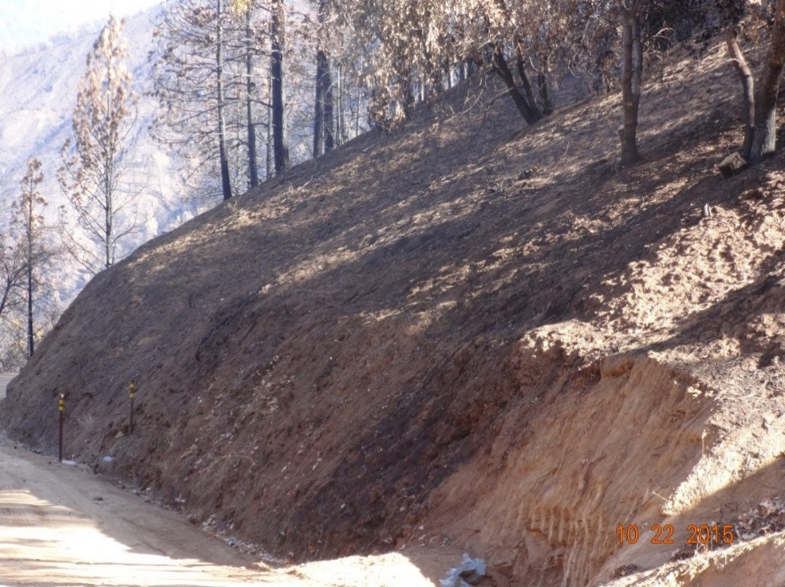
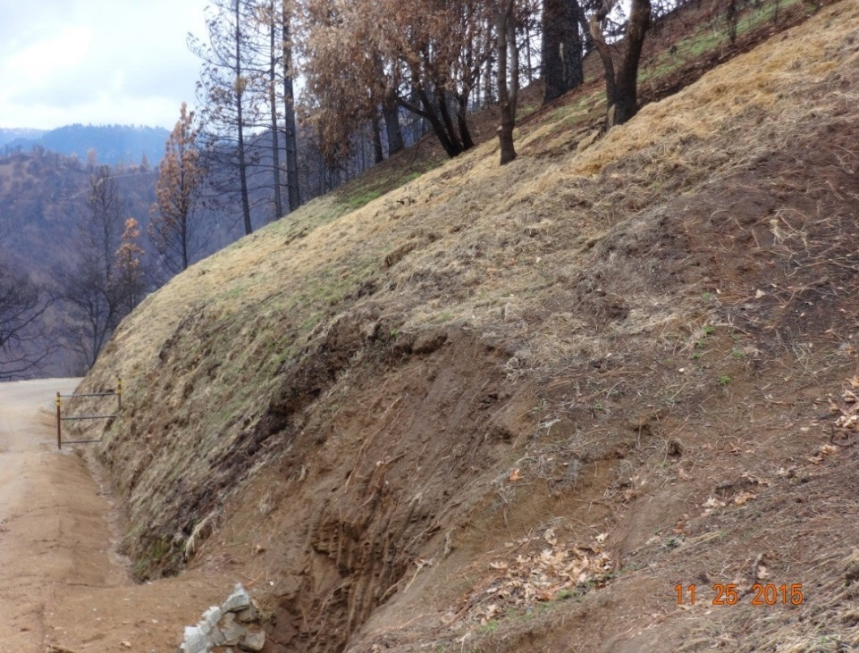
Federal Emergency Management Agency
Climate resilient Mitigation
Kayed Lakhia, Director
Hazard Mitigation

Slide 4
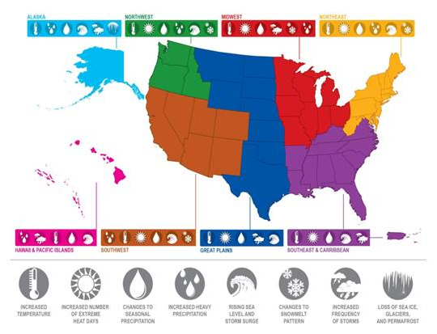
FEMA Hazard Mitigation Assistance

Slide 5
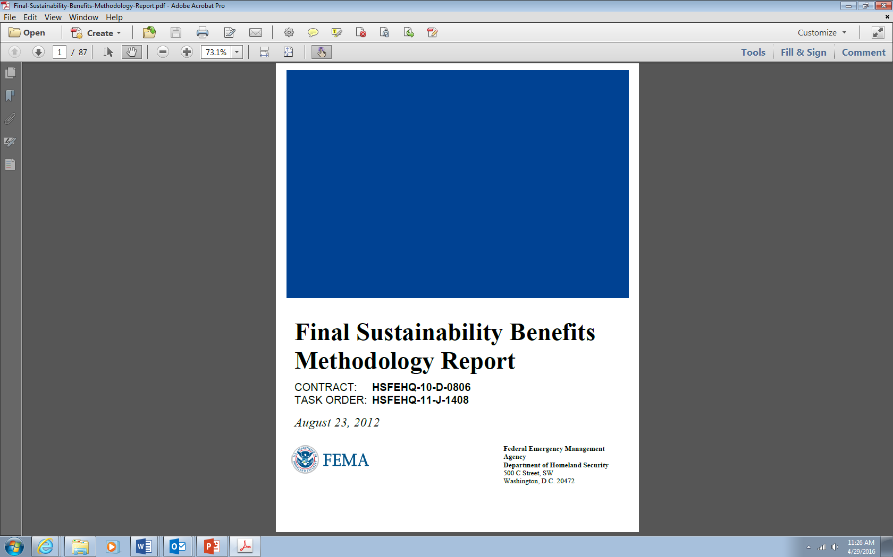
Ecosystem Service Benefits
All HMA projects must demonstrate they reduce risk and are cost effective
  FEMA BCA Toolkit can be used to calculate the project’s cost effectiveness
Ecosystem Service Benefits - beneficial goods and services provided by nature for people (e.g. habitat restoration, improved air/water quality)
  June 2013, FEMA allowed ecosystem services to be included in acquisition/open space projects
  In 2015, ecosystem service values updated to include more values and types of ecosystem services, allow ecosystem services for all HMA actions that benefits or enhances the environment

Slide 6
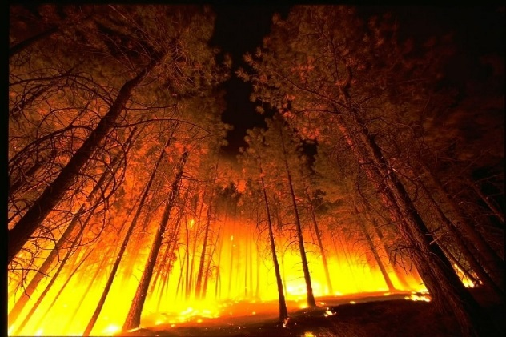
FMAG-HMGP Pilot
FMAG-HMGP Pilot authorized by FY15 DHS Appropriation Act provision that allowed HMGP for Fire Management declarations between 3/4/15 – 12/11/15.
Addresses a gap to provide HMGP mitigation assistance for Fire Management Declarations when there is no major disaster declarations
  Flood risk and erosion increase post-wildfire
  El Nino – anticipated impacts of increased precipitation in wildfire impacted areas
Funding
  Up to $331,166 - States with standard
  hazard mitigation plans
  Up to $441,555 - States with enhanced
  mitigation plans
Expedited implementation of pilot program
  Wildfire pre-calculated benefits
  Advance Assistance
  Emergency environmental review

Slide 7
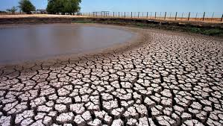
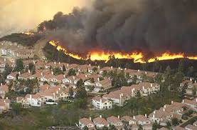
FMAG-HMGP Pilot
The FMAG-HMGP Pilot has resulted in 34 events
totaling $14 million
Three approved FMAG-HMGP Pilot projects
Lake County, California – FMAG/HMGP Pilot
  September 2015 California wildfires
  Fatalities and damages to structures
  Lake County received 2 FMAG declarations
  Pilot funding of $441,555 for each declaration
Wildfire Mitigation was a Community Priority
  Concern about more flooding in burn area
  during El Nino rains
  Chose to upsize culverts to mitigate flood risk
Utilized FMAG/HMGP Pilot Efficiencies
  Use of pre-calculated benefits
  Emergency action - EHP process
:

Slide 8
Resources
Hazard Mitigation Assistance website: https://www.fema.gov/hazard-mitigation-assistance
Climate Resilient Mitigation Activities website: https://www.fema.gov/climate-resilient-mitigation-activities-hazard-mitigation-assistance
Benefit Cost Analysis: https://www.fema.gov/benefit-cost-analysis
Questions?

Slide 9

Using Data to Grow the Energy Financing Market
Montgomery county’s Data-driven approach to green banking
Michelle Vigen, senior energy planner
Montgomery County, MD
Wednesday, May 04, 2016
Climate Action 2016 Forum
University of Maryland

Slide 10
What a local government can do to push a market
Policies and Goals
Greenhouse Gas Reduction Goal
Commercial Building Energy Benchmarking and Transparency
Commercial PACE Financing
Green Building Tax Credits
Support Utility Efficiency Programs
Local Green Bank
Notes:
Montgomery County strives to be a leader in implementing policies and programs that support energy efficiency and clean energy, particularly in our business sector.
In 2009, we set a Greenhouse Gas Reduction Goal, and noted that a full 1/3 of our emissions come from our commercial building sector. This presents a ripe opportunity to help our businesses and building owners increase their performance and bottom line.
To that end, we have passed a commercial building benchmarking law, requiring building owners to report energy data to the county for disclosure.
We have also launched a commercial PACE financing program
We provide generous tax credits for new construction that meets varying levels of LEED certification
And we work to support utility energy efficiency programs
Our latest endeavor is to establish a local green bank, in order to use limited public-purpose funds to leverage private capital to advance energy efficiency and clean energy in the county.

Slide 11
What a Green Bank can do
Partnering with
Private Capital
Leverage private dollars
Address Market Gaps
Standardization and Data
Support Demand and Build Volume
Reduce Risk through innovative financing
Connecticut Green Bank
 | FY12-FY15 (CGB) ¹
Model | Financing
Clean Energy (MW/yr) | 33.63
FY16 Targets (CGB) ²
Financing
110.0
Investment ($MM/yr) | $165.8
Leverage Ratio | 3:1
% of Funds as Loans | 56
$670.0
10:1
80
Example of CT Green Bank, provided by Coalition for Green Capital
Notes:
The opportunity we face is significant:
Green Banks are established primarily on a state level, but they all generally do the same thing.
Leverage private dollars with public-purpose dollars
Connecticut approaching 10:1 leverage ratio and $670MM in investment
Address market gaps across all sectors: Residential, Commercial & Industrial, Multifamily, Low Income, MUSH Market, Distributed Generation and Grid 2.0, Storage, Alternative Fuel Vehicles…expand into Water and Resiliency
Provide standardization: Work with lending stakeholders to build knowledge base and data around energy investments – Data collection, Aggregate Marketing
Support demand and build volume: Combine non-financial technical assistance with tailored financial solutions
Reduce risk through innovative financing: Credit Support, Co-Investment, Warehousing, Subordinated Debt, Guarantees/Loan Loss Reserves, Securitization

Slide 12
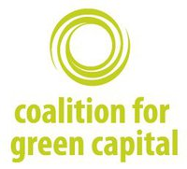
Building a Green Bank
Nation’s First Local Green Bank
Green Bank Legislation: June 2015
  Public-Purpose Private Entity
  Increase investment in clean energy deployment
Coalition for Green Capital: Implementation Support
  Market Research
  Governance and Incorporation
  Fundraising
Currently: Wrapping up Work Group, Recruiting Board of Directors, Bylaw Development
Notes:
To that end, Montgomery County passed legislation last summer to establish a Green Bank – the nation’s first local institution, explicitly designed to spur private investment in clean energy deployment.
We are grateful for the generous support of the Coalition for Green Capital – they are providing market research, assistance in developing our governance documents and incorporating the nonprofit, as well as advising fundraising.
As of today, we are wrapping up the work group process, recruiting our initial board of directors, and going through incorporation and bylaw development.

Slide 13
Building a Green Bank
Learning about Community Needs/Opportunities
Work Group
  400+ email subscribers, 50+ committee members, 30+ super members
  Fundraising, Governance, Marketplace Development
Coalition for Green Capital: Market Assessment
  Landscaping
  Market Sizing
  Recommendations

Slide 14
$2.7 billion of clean energy potential in the County
Selected Technologies |  | Total Current Installed Capacity | Total Potential Market | Total Unfilled Potential Cost
Wind |  | 0 MW | N/A | $0
Solar PV | Residential | 14.3 MW | 182 MW | $549 M
 | C&I | 13.7 MW | 175 MW | $308 M
Energy Efficiency | Electric | 896 GWh | 3,842 GWh | $879 M
 | Thermal | N/A | 9,032 BBtu | $701 M
Bioenergy Electric Generation¹ |  | 54 MW | 31 MW | $122 M
Combined Heat & Power |  | 67 MW | 75 MW | $90 M
TOTAL |  | N/A | N/A | $2,652 M
Notes & Sources: (1) Only includes power generation, does not include bioenergy used for end-use efficiency. Only estimates technical potential. SEIA, EIA, NREL, GTM, EmPOWER, ACEEE, DOE, GDS, EEFA, CHP Market Analysis
Notes:
According to our Market Assessment study done by the Coalition for Green Capital, a nonprofit providing us support for our Green Bank implementation, the County has $2.7 billion worth of clean energy potential. This is primarily in solar and efficiency. This data takes into account what’s been done already, what is cost-effective considering existing programs, and what is technically possible.
No program can provide that amount of capital, and we can’t expect our building owners to make that level of investment from their own capital improvement budgets.
Rather, we need to facilitate the entry of private investment into this market. These numbers represent a huge opportunity for the investment community, and while we know these types of projects are smart investments, much work remains to convince the broader conventional lending industry of that.

Slide 15
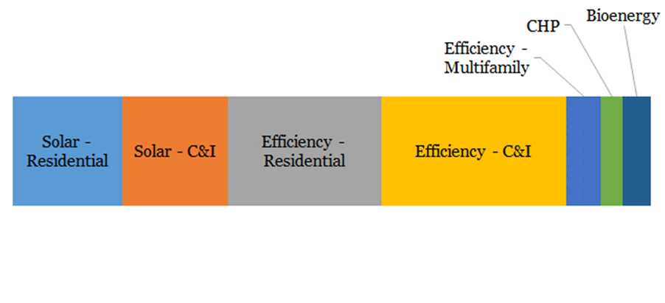
$2.7 billion of clean energy potential in the County
$900 Million
Solar Opportunity
$1.5 Billion
Efficiency Opportunity
Graphic compiled by Coalition for Green Capital on behalf of Montgomery County
Notes:
According to our Market Assessment study done by the Coalition for Green Capital, a nonprofit providing us support for our Green Bank implementation, the County has $2.7 billion worth of clean energy potential. This is primarily in solar and efficiency. This data takes into account what’s been done already, what is cost-effective considering existing programs, and what is technically possible.
No program can provide that amount of capital, and we can’t expect our building owners to make that level of investment from their own capital improvement budgets.
Rather, we need to facilitate the entry of private investment into this market. These numbers represent a huge opportunity for the investment community, and while we know these types of projects are smart investments, much work remains to convince the broader conventional lending industry of that.

Slide 16
Ground-truthing through Interviews
Supply – Side
Lenders want to see credit enhancements, savings guarantees, or co-investment strategies that de-risk investments and make the process easier for them
Lots of incentives, limited financing options with variety of terms/structures, few lenders willing to include savings in the underwriting process
Need for expertise/clarity to navigate deal complexity, financing options, understand impact on customer cash flows and building value/NOI
Demand – Side
Customers need zero upfront cost, have immediately positive cash flows, and have simple process
Customers need a turnkey solution that requires minimal effort
Customers need more and clearer information, and trusted, central source of information

Slide 17
Governance drives Mission:
Mission drives Activities
Board of Directors
Priorities of the future Board of Directors will determine Green Bank activities
Green Bank Work Group + DEP
Market Assessment & Recommendations
Consolidate Data and Information
Policy Goals and Needs
Economic Development
EE and RE Potentiality
Stakeholder Insights

Slide 18
Thank you
Green Banking affords a unique opportunity
Magnitude of work requires private capital partnership
Role of public institutions in building a market
Learn about your market
Work Group: Stakeholder Insights
Market Assessment Research
Contact: Michelle Vigen | michelle.vigen@montgomerycountymd.gov

Slide 19
Clean Water Partnership Project Overview
Presentation to the University of Maryland’s Climate Action 2016 Forum

Slide 20

Prince George’s County, Maryland
Stormwater regulatory compliance
    Challenges
  National Pollutant Discharge Elimination System’s (NPDES) Municipal Separate Stormwater System (MS4) permit requirement
    Treat 20% of impervious area (6,000 acres) by 2019
  EPA’s Chesapeake Bay total maximum daily load (TMDL) requirement
    Treat 15,000 impervious acres by 2025
  Estimated cost: $1.2 billion
    Solution
  Form innovative public-private partnership (P3)
  Implement stormwater utility fee
Copyright © 2015 Corvias Solutions, LLC

Slide 21
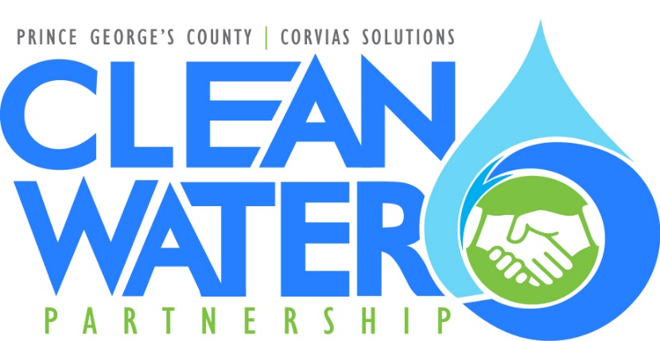
The Clean Water Partnership
Retrofit 2,000 impervious acres
  Automatic 2,000 additional acres
30 year full life-cycle partnership
  $100M initial development period
  $235M in total development with O&M
Design, Build, Operate, Finance, and Maintain whole-system solution that will deliver better, more efficient services through every phase
Commitment to utilization of local, small, and minority-owned businesses performing 30-40% of work
Community and social economic development through alternative compliance with faith based groups, mentor protégé program, and workforce development
2016 Performance To-Date
  1,424 acres in development
  $36 million budget
  $8 million in contractual commitments to the local economy to date
  $48 million financing application pending with the Maryland Department of the Environment State Revolving Fund program

Slide 22
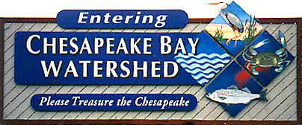
Key Financing Attributes of p3
Access to flexible, innovative financing solutions that are comparable to tax-exempt debt
  Stormwater Utility fees contain the fundamental & prerequisite collateral to secure private capital
  Fixed fees directly linked to performance obligations
  Operations and maintenance funded throughout the life of project
  Project savings are reinvested in project or returned to municipality
  Economies of scale, project aggregation, streamlined procurement process and collaboration create cost savings and faster implementation
  Risks are allocated to the parties best able to manage them
Private financing reduces demands on the public’s bonding capacity, freeing up funds for other public services
Copyright © 2015 Corvias Solutions, LLC

Slide 23

Helping Cities
RE.invest,
RE.bound & RE.imagine Predevelopment
Ellory Monks
UMD Climate Action 2016 Forum
May 4, 2016
.

Slide 24
Designing & Financing for Resilience
Whenever I run into a problem I can’t solve, I always make it bigger. I can never solve it by trying to make it smaller, but if I make it big enough, I can begin to see the outlines of a solution.
Dwight Eisenhower

Slide 25
3 Initiatives, 3 Projects, 3 Financing Strategies
  RE.invest Initiative – Hoboken, NJ
      Design: Stormwater Management + Parking + Green Infrastructure
      Finance: NJEIT + Parking Fees
  RE.bound Program – Miami Beach, FL
      Design: Seawall Retrofits + Flood Management
      Finance: resilience bond (insurance savings capture)
  Build it Green (BIG) Initiative – New Jersey CSO Communities

Slide 26
1. The RE.invest Initiative

Slide 27
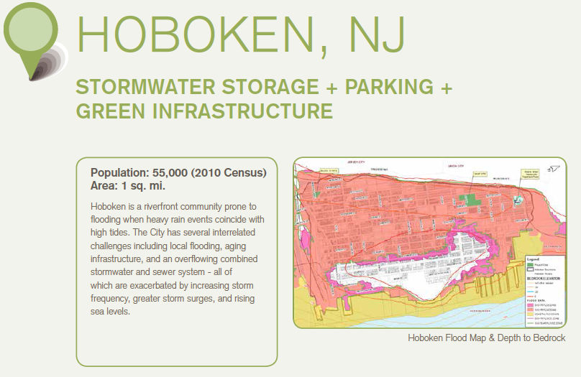

Slide 28
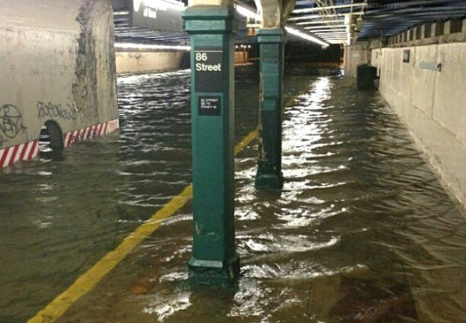
The High Cost of Infrastructure Failure
Image credit: weather.gov

Slide 29
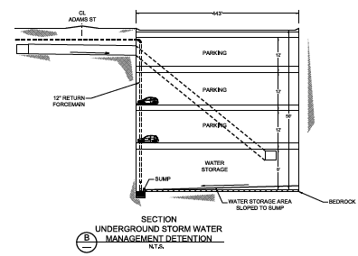
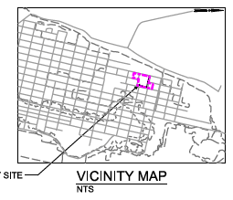

Slide 30

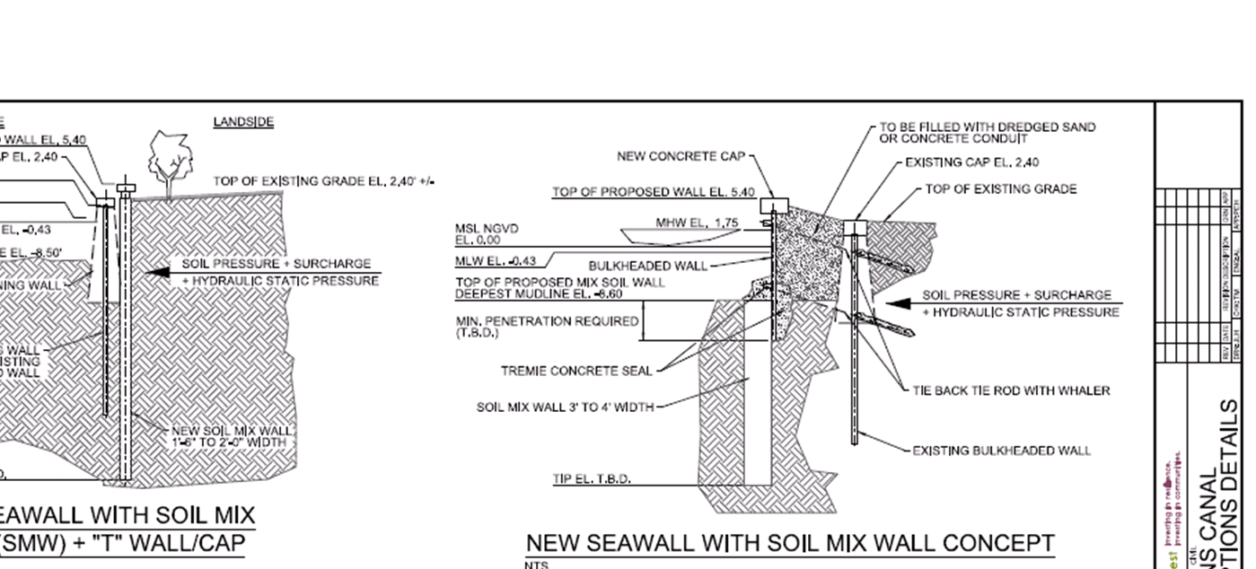
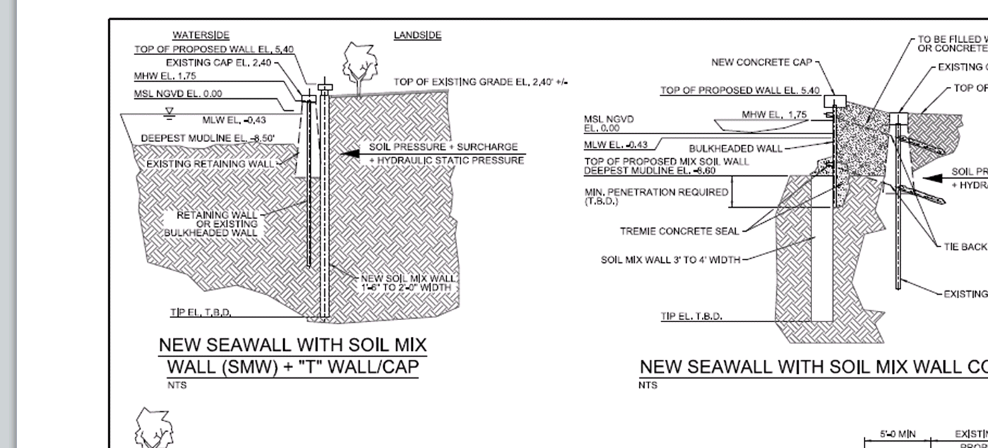

Slide 31
2. The RE.bound Program

Slide 32
Infrastructure as Financial Risk Reduction
  Resilient infrastructure is designed to reduce risk
        Public sector assets & services are safer
        AND insurance companies lose less money when public & private policy holders are better protected
  Resilience Bonds are one way of ensuring the financial value created by these public investments returns to the public sector
PROJECT
INSURANCE
REBATE

Slide 33
3. The Build it Green (BIG) Initiative

Slide 34
3 New Jersey Combined Sewer Overflow (CSO) Communities
  Integrated Solutions TBD
        Porous pavement + broadband, road repairs, parking upgrades
        Green space + vacant lots, urban revitalization, playgrounds
        Tree trenches + bike lanes, pedestrian walkways
  Financing Strategies TBD
        Private sector engagement
        Additional grant sources
        Long-term: social impact bond?

Slide 35
Questions?
Contact: info@refocuspartners.com

Slide 36

Resilience & sustainability

Slide 37

0

Slide 38
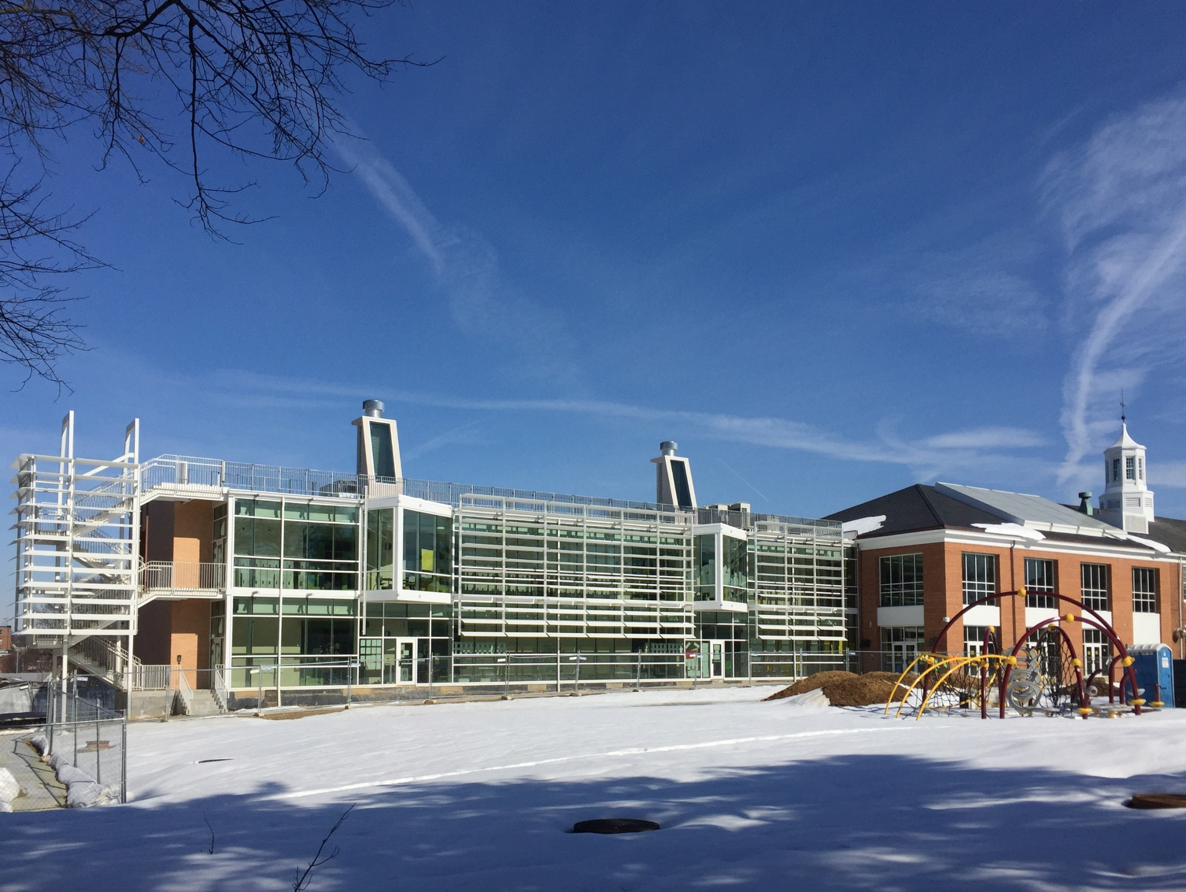
Schools

Slide 39
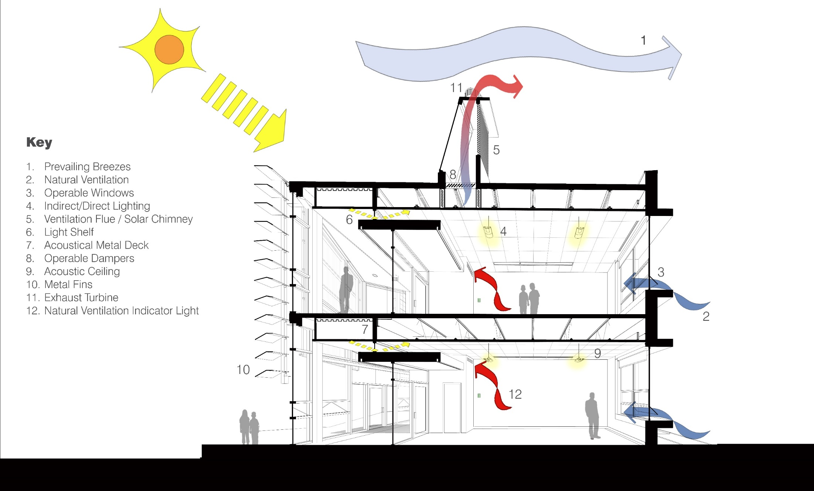

Slide 40
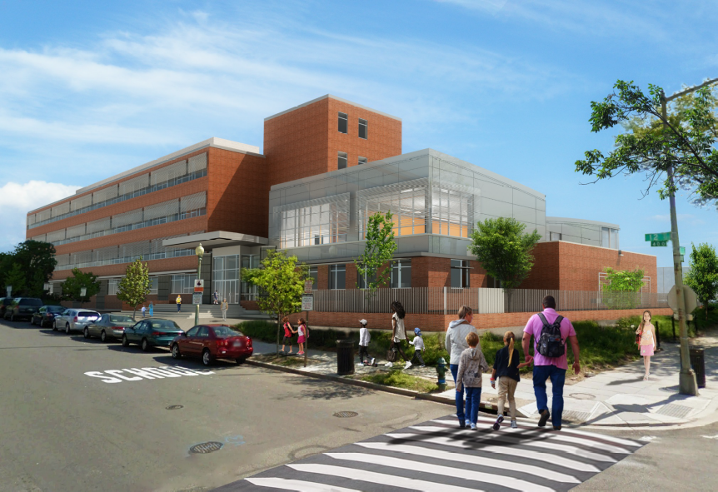
Shade Wall @ Watkins Elementary School
Cost of Shades (50%): 10,750 SF x $25/SF = $268,750
Savings in HVAC First Cost: 28 tons x $8,000/ton = $224,000
Savings in HVAC Operating Cost: 28 tons x 1,500 hrs/year x 0.75 kw/ton x $0.15/kwh = $4, 725/year in electricity.
  1) Total Net Savings= $41,495
  2) Savings to Investment Ratio (SIR) = 1.93
  3) Annual Internal Rate of Return (AIRR) = 5.74%
  4) Simple Pay Back (SPB) = 10 years
  5) Life Cycle Emission Reduction: 932 metric tons C02;
  3 metric tons S02; 1.4 metric tons NOx

Slide 41


Energy Conservation- Payback
ECM | Average Cost by School | Cost/SF | Payback | Value
Building Automation System - BACNet | $15K-50K | NA | 9 month | 20% reduction on annual energy costs, as seen at Dunbar
Envelope Enhancement | $47.5K | $0.96 | 2.7 years | Savings, on average, of $250,000 over the life of the building.
LED lights | $1.25M | $6.38 | 4 years | LED lights are 30% more efficient, and last 6 times longer, reducing maintenance.
Daylight Controls | $424K | $2.45 | 4 years | Accurate light levels in academic spaces provide an optimal learning environment.
Lights Fins- Shading | $280K | $varies | 10 years | Reduced HVAC costs, size, and demand.
Greywater Reuse | $540K | $2.50 | 10 year | Have Stormwater credits and do not have to pay a fee for not meeting the requirements. Reduced Watershed impact- meets DDOE-EPA requirements

Slide 42

Baseline Energy
Collect Water, Waste, Gas, and Energy Data.
Establish a Baseline and Optimize Performance
One Example Project: Whittier Elementary Renovated in FY10 had a 29% savings.
M BTUs FY09 | M BTUs FY10 RENO | M BTUs FY11 | M BTUs FY12 | M BTUs FY13 | Percent Energy Saved
64 | 59 | 49 | 46 | 47 | 29%

Slide 43
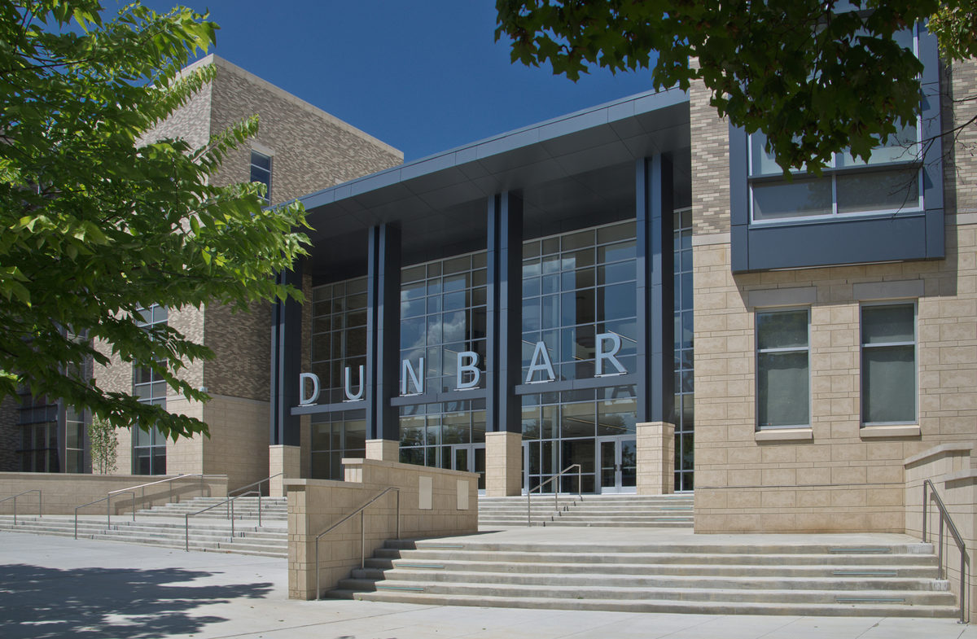
Dunbar High School

Slide 44

How efficiency turns into
An East West Building Orientation 5%+ passive solar design 10%= 15% energy savings.
Geothermal system reduces energy consumption by 18% or $200K
PPA Solar panels offset 14% of the total energy demand.
Low-flow plumbing fixtures decrease water usage by 50% saving 1.4 Million Gallons a year or in DC $7,840 annually. ($5.60/1,000 gal)
  O “Green” Street absorbs all the water from 1.2 inch rain event.

Slide 45
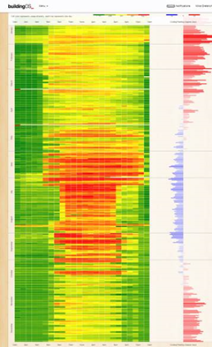
Dunbar High School Case Study

Slide 46
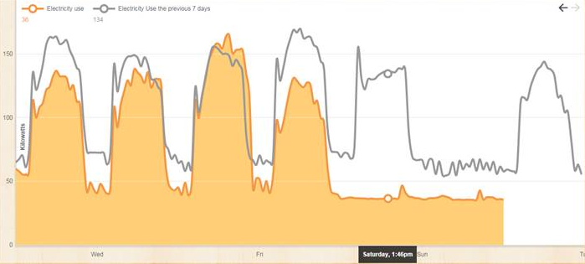
Ludlow Taylor Case Study
Energy savings via setting back Saturdays in addition to Sundays at Ludlow Taylor ES.
By implementing this setback we are reducing the energy consumption of the school by 1,779 kWh (this Saturday at 894 kWh last Saturday 2,673 kWh) or 15% or at $0.12 kwh = $213 week or $11,000 a year in savings according to the weekly consumption noted on the graph.

Slide 47
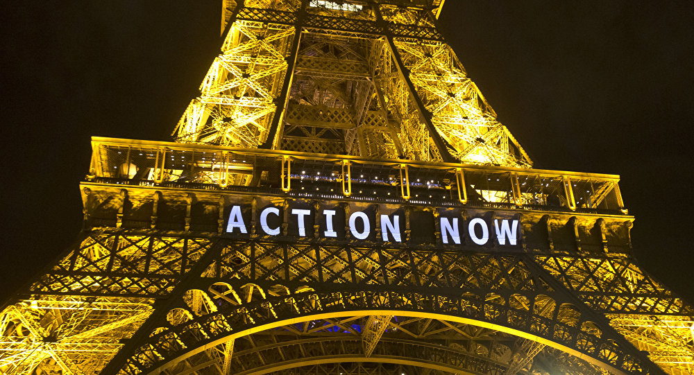

Slide 48
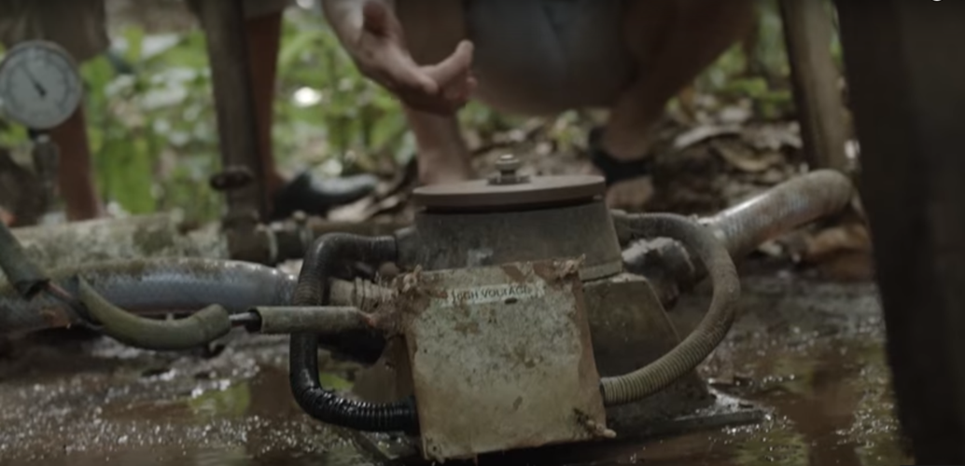

Slide 49
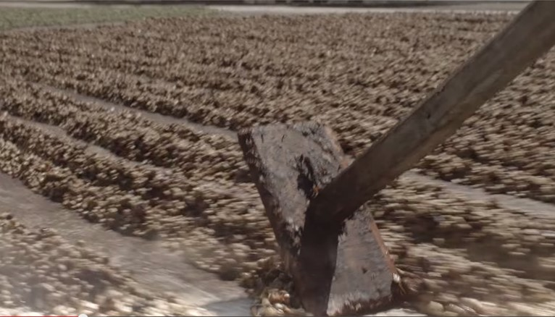
Costa Rica

Slide 50


