Slide 1
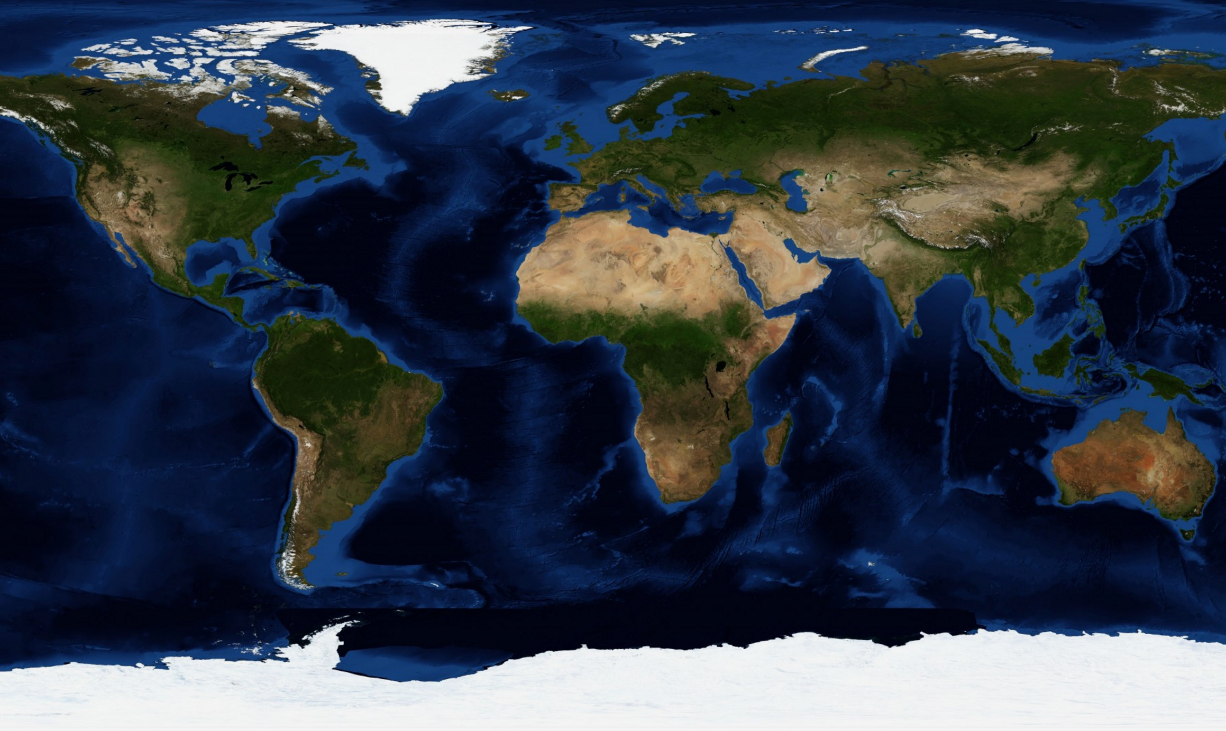

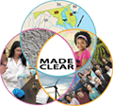
The Role of Academic and Research Institutions in Climate Implementation:
The Case of MADE CLEAR
J. Randy McGinnis, University of Maryland, College Park
Learning Sciences Team Leader (UMD)
Special thanks to Emily Hestness for PPT Graphics
  Maryland and Delaware Climate Change Education, Assessment, and Research
Notes:
I have been involved in climate change education (implementation in teacher education and in pedagogical research) for a decade. I am housed in the College of Education with a science specialization in geoscience.

Slide 2
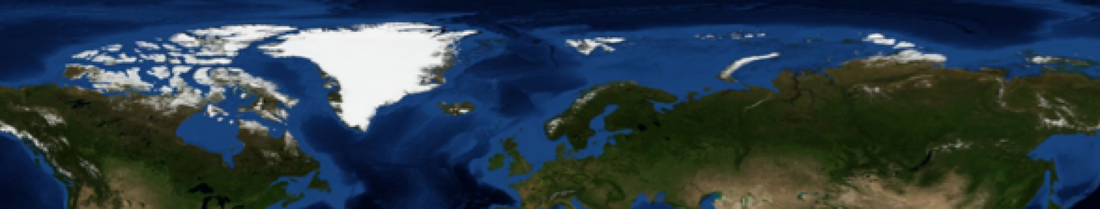
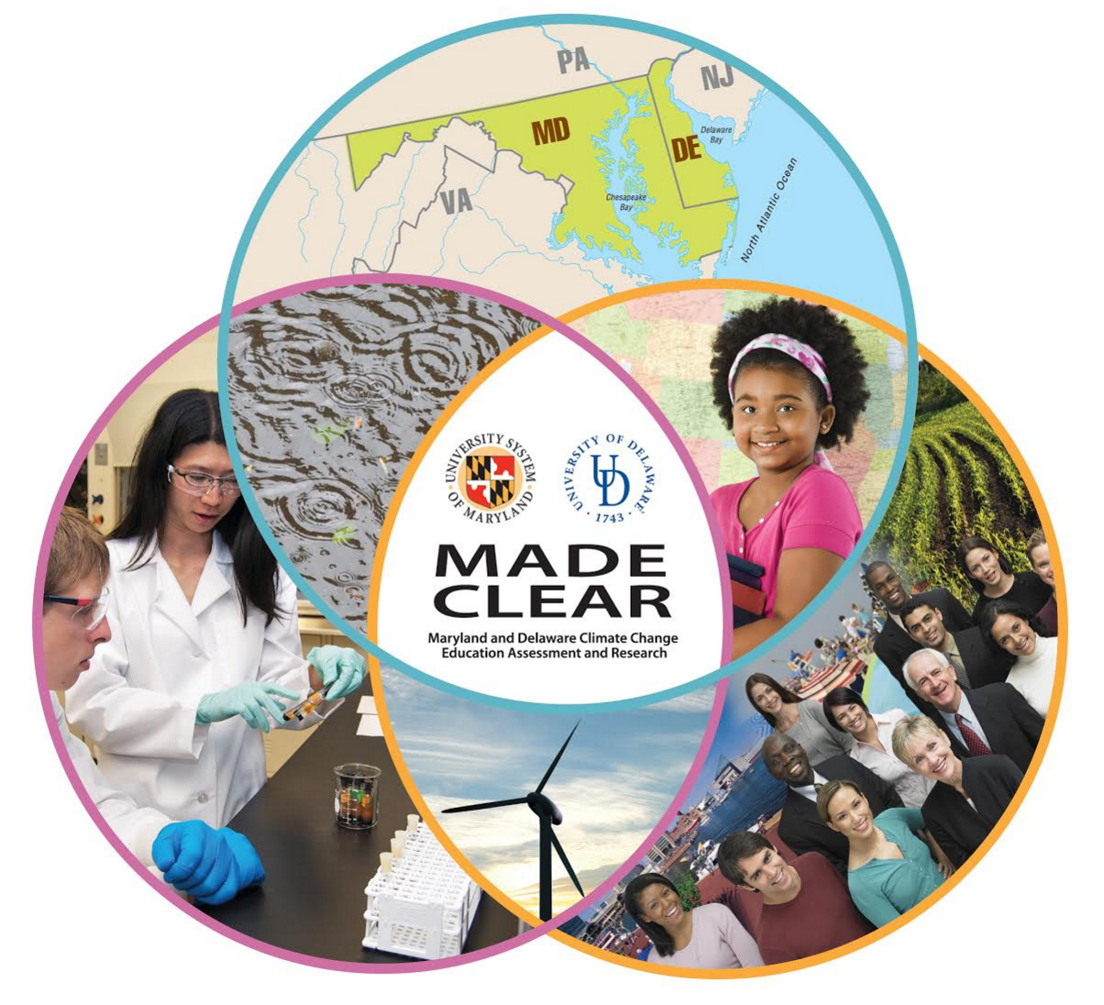

MADE CLEAR Overview
Maryland and Delaware Climate Change Education, Assessment, and Research (MADE CLEAR, 2010-2017)
NSF Phase I & II Climate Change Education Partnership (CCEP) grant
Partners include:
Notes:
Lead PIs: Don Bosch, Co-Pis, Nancy Shapiro and Nancy Target

Slide 3
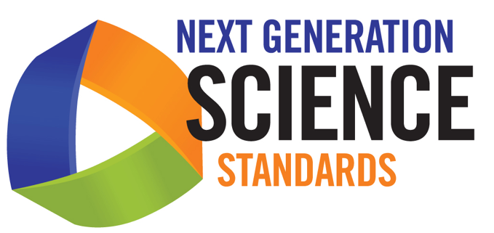
Recent Policy Change in the US Science Standards: Next Generation Science Standards (2013)
www.nextgenscience.org
Notes:
Game changer in climate change education in the USA, because the NGSS includes the climate change topic in the standards for the first time.
The NGSS came out during the time of the Common Core Initiative, which has prompted some confusion in education in the USA.

Slide 4
MADE CLEAR Climate Change Education Responsibilities in Higher Education
• Promote and support Climate Change Education in the Academy’s Coursework
--Undergraduate Science courses
--Teacher preparation science methods courses
• Conduct Groundbreaking Educational Research
Notes:
As time permits ,touch on some portraits of excellence in climate change education at UMD—CMNS and in the COE (EDCI 372). Emphasis on causes and mechanism, resilience and perseverance.
U.S. Global Change Research Program's Climate Literacy: some concrete things a "climate literate person" should be able to do:
1) understand principles of climate science;
2) assess scientifically credible information;
3) communicate about climate change;
4) make informed and responsible decisions.
Talk about Ed Research: Developing Learning Progressions for three major consequences of climate change and for change change) and case studies of implementation in teacher ed and in K-12 classrooms (a sociocultural focus).
U.S. Global Change Research Program's Climate Literacy: some concrete things a "climate literate person" should be able to do:
1) understand principles of climate science;
2) assess scientifically credible information;
3) communicate about climate change;
4) make informed and responsible decisions.

Slide 5
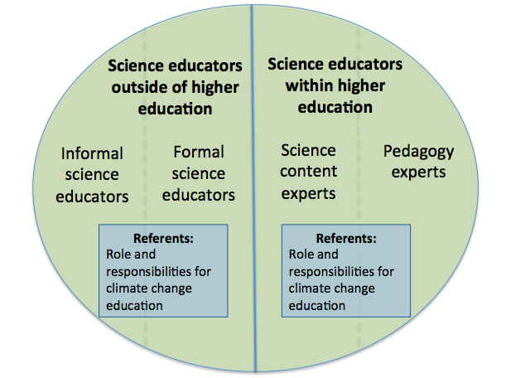
Conceptualizing the Larger Climate Change Education Community Consisting of Higher Ed and Beyond
Notes:
End with this key areas to consider: roles and responsibilities for climate change education.

Slide 6
MADE CLEAR websites:
www.ClimateEdResearch.org
www.madeclear.org
This material is based upon work supported by the National Science Foundation under Grant No. 1043262. Any opinions, findings, and conclusions or recommendations expressed in this material are those of the author(s) and do not necessarily reflect the views of the National Science Foundation.
Notes:
Mention that the websites link to many resources for all members of the climate change education community—educators and education researchers.

