Slide 1
Using Analysis and Tools to Inform Adaptation and Resilience Decisions
-- the U.S. national experiences
Jia Li
Climate Change Division
U.S. Environmental Protection Agency
Climate Action 2016 Forum
May 4, 2016

Slide 2
Policy Background for Adaptation and Resilience Actions at National Level
Executive Order 13514 Federal Leadership in Environmental and Energy Performance (2009)
  Federal agency adaptation planning
Interagency Climate Change Adaptation Task Force recommendations (2010)
  Mainstream adaptation in agency planning, operations and programs
  Use the best available science to support adaptation decisions
  Evaluate performance using measurable metrics
The President’s Climate Action Plan (2013)
  Encourage climate resilient investments (e.g. infrastructure, transport, natural resource)
  Use sound science to manage climate change impacts
  Strengthen global resilience to climate change and mobilize climate finance

Slide 3
Policy Background (2)
Executive Order 13653 Preparing the United States for the Impacts of Climate Change (2013)
  Requests agencies to develop and provide scientific and accessible data and tools
Hurricane Sandy Rebuilding Strategy (2013)
  Established guidelines for comprehensive, forward-looking and science-based analysis of future climate risks, including cost-benefit analysis of infrastructure strategies
State, Local, Tribal Leaders Adaptation Task Force Recommendations (2014)
  Provide actionable data on climate impacts and related tools to support decision-making
  Improve economic analysis to understand the costs and benefits of resilient investments

Slide 4
Scientific Assessments and Tools for Adaptation and Resilience Actions
Development of analysis and tools at U.S. national level are driven by
  state, local, tribal, and community stakeholder interests and needs
  policy directives
  federal funding and technical assistance program requirements
Federal government plays an important role in providing leadership, guidance, information, tools and financial support for climate resilience actions
Diverse programs, networks, tools and guides developed at national, sectoral, regional and local levels to support adaptation and resilience actions

Slide 5
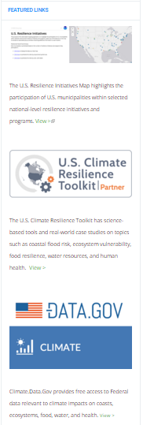
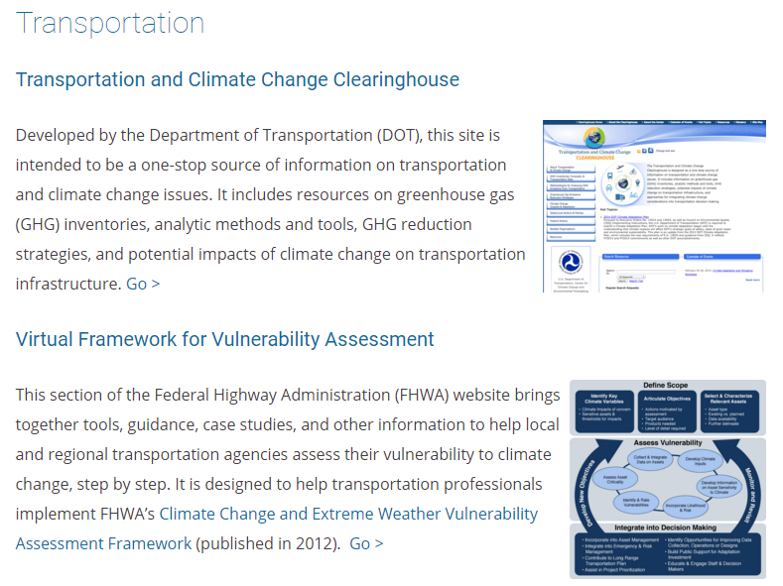
Federal Resources for Adaptation
Built Infrastructure
Human Health
Natural Resources
Disaster Response
Observations & Monitoring
Regional Climate Information & Modeling
Communication & Training
http://www.globalchange.gov/browse/federal-adaptation-resources

Slide 6
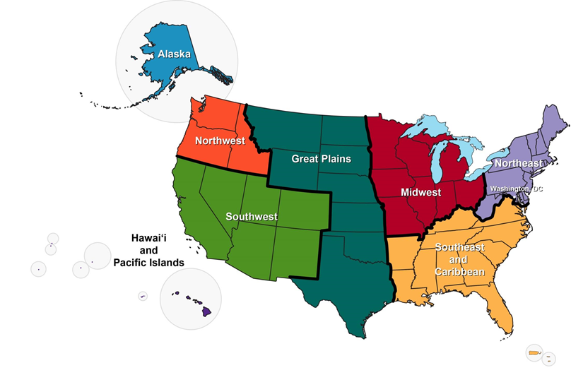
National Climate Assessments
Our Changing Climate
Sectors
  Water Resources
  Energy Supply and Use
  Transportation
  Agriculture
  Forests
  Ecosystems and Biodiversity
  Human Health
  Energy, Water, and Land Use
  Urban Systems and Infrastructure
Response Strategies
Indigenous Peoples, Lands, and Resources
Land Use and Land Cover Change
Rural Communities
Biogeochemical Cycles
Oceans and Marine Resources
Coastal Zones
Decision Support
regions

Slide 7
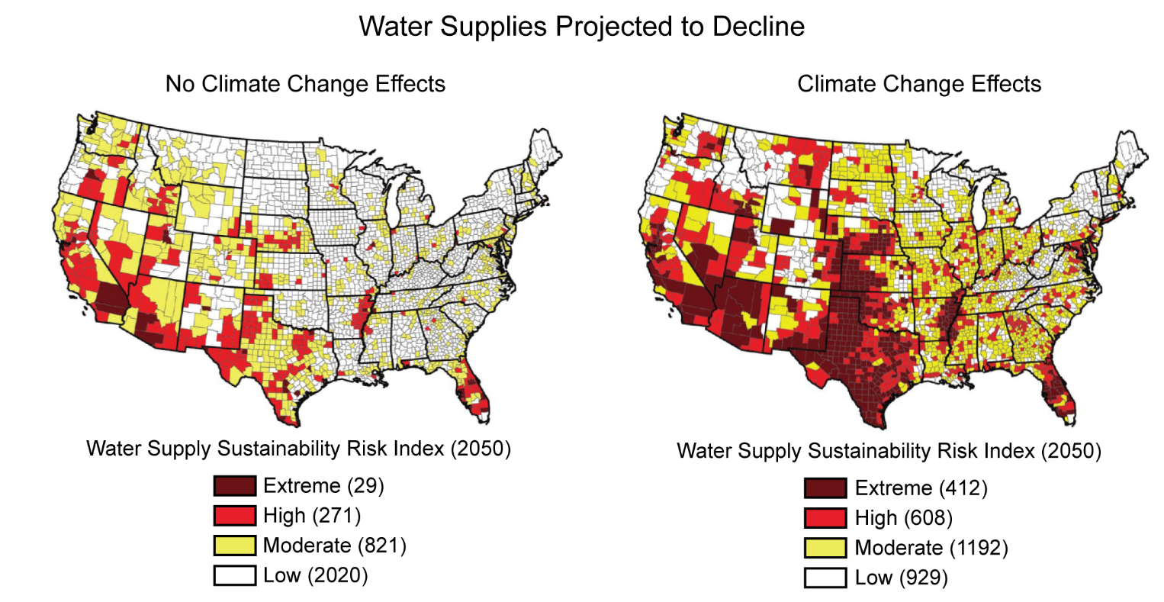
3rd National Climate Assessment (2014)
Source: http://nca2014.globalchange.gov/

Slide 8
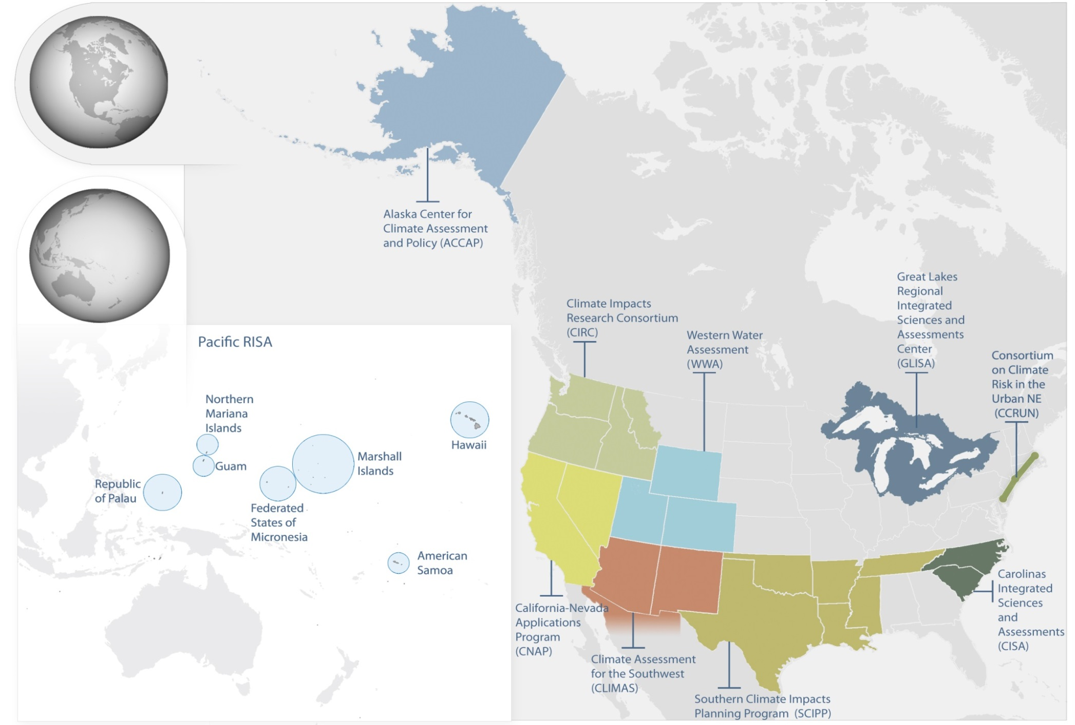
NOAA RISA Program

Slide 9
NOAA RISA Program
INFORM DECISIONS
USABLE SCIENCE
(RISA)
ADVANCE
UNDERSTANDING
inform
enhance
UNDERSTAND CONTEXT
Food production
Forests
Ecosystems
Transportation
Urban
Water
Anthropology
Economics
Decision Science
Climate & Weather
Earth & Hydrology
Ecology & Biology
Communication & Education
UNDERSTAND
RISK
SUSTAIN KNOWLEDGE NETWORKS
INNOVATE SERVICES
LEARN THROUGH PRACTICE
http://cpo.noaa.gov/climateprograms/climateandsocietalinteractions/risaprogram.aspx

Slide 10
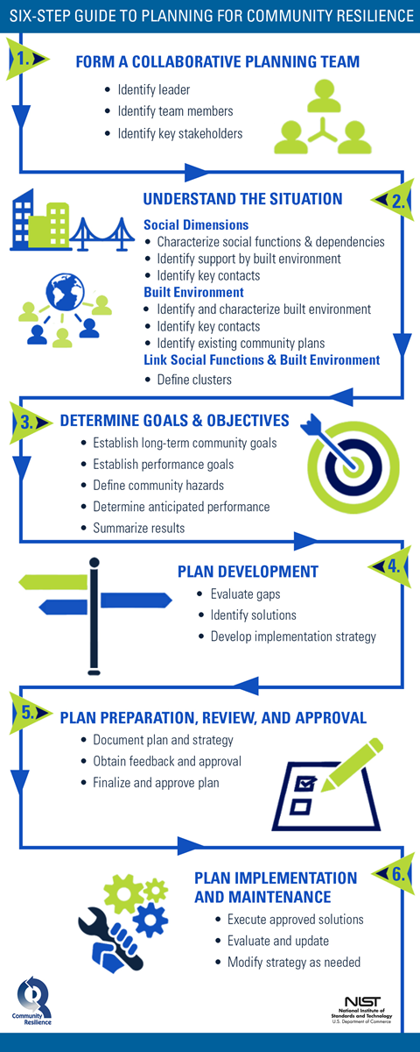
NIST Community Resilience Planning Guide
http://www.nist.gov/el/resilience/

Slide 11
Economic Analysis to Support Adaptation and Resilience Actions
Evaluate costs and benefits of adaptation actions at various levels (local, regional, sectoral, national, international)
Assess effectiveness of adaptation policies and interventions
Understand pathways of and barriers to adaptation (e.g., market, regulatory, informational, financial, behavioral)
Evaluate cross-sector and economy-wide impacts of adaptation policies
Illuminate interactions and tradeoffs between mitigation and adaptation
Characterize uncertainty of climate impacts

Slide 12
Emerging Experiences
Strong interests in reliable and accessible information by decision makers to understand climate risks, vulnerabilities, and response options
Implementation of adaptation actions has been slow at all levels, partially due to constraints in funding, accessible information and uncertainties
Sustained engagement and collaboration between scientists, decision makers and stakeholders important to support sound decision-making
Urgent needs to integrate natural and social sciences to support analysis and implementation
Few evaluations of the effectiveness of adaptation actions and efficiency of alternative approaches
Little systematic evaluation of information and tools from users’ perspectives

Slide 13
Gaps and Future Research Needs
Understand vulnerabilities and their drivers
  Factors (e.g., socio-economic, demographic, institutional) influence vulnerabilities, adaptive capacity
  How vulnerability and drivers evolve over time and in response to climate change
Provide and integrate data, tools and analytical insights across scales
  Integrated assessment modeling, impacts, vulnerability and adaptation (IVA) research
Communicate risks and uncertainty
  Modeling and characterization of uncertainty
  Decision-making under uncertainty
Measure (resilience) outcomes
  Develop metrics and indicators for MRV
  Evaluate effectiveness of adaptation actions
Evaluate effectiveness of analysis, tools and networks in supporting decision-making
  Understand decision contexts and user needs

Slide 14
Acknowledgements
Chelsea Combest-Friedman, National Oceanic and Atmospheric Administration
Emily Cloyd, U.S. Global Change Research Program
Jennifer Helgeson and Steve Cauffman, National Institute of Standards and Technology
John Furlow and Jonathan Cook, U.S. Agency for International Development

